Slide 1
Hypothesis testing with the the Northwind database
Discount Levels
Product sales by product
Product sales by category
Best employee by sales amount

Slide 2
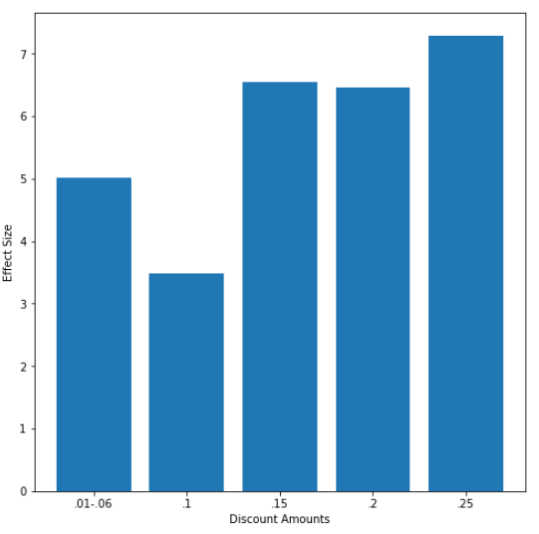
Discount Levels
Difference between the mean sales by quantity of each discount level and the mean sales by quantity of the non-discount sales

Slide 3
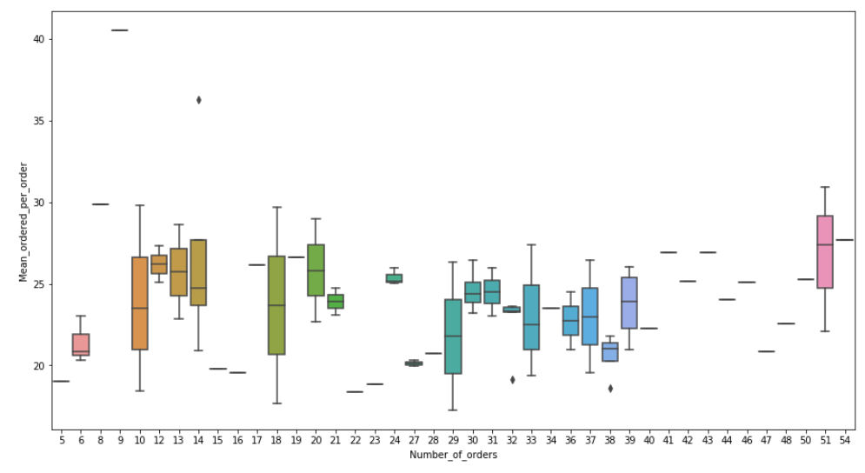
Product sales by product
Finding a range that will find the best products

Slide 4
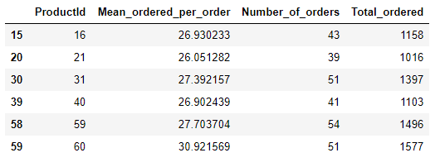
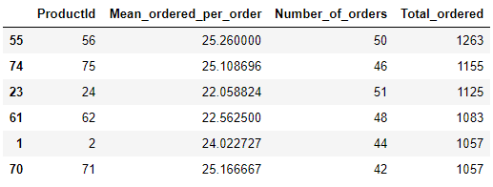
Product sales by product
Mean > 26 Number of orders > 38
Total ordered over 1015, that are not in the above list
Best product: Number 60

Slide 5
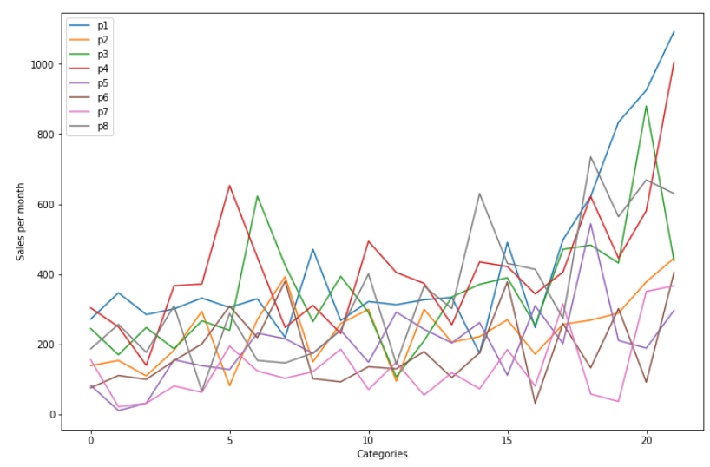
Product sales by category

Slide 6
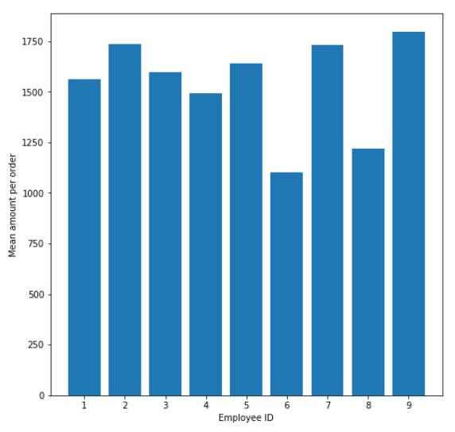
Best employee by sales amount
Can not find an Employee that is statistically, significantly better by mean sold per sale

Slide 7
Recommendations
Using .05%, .15%, .20% and .25% as discount amounts to try and drive sales.
I would suggest the company focus on 60, 16 and 31
Focusing on seeing what other products can be sold in categories 1,3,4 and 8 At the same time try to get better at selling in the other categories 2,5,6 and 7
I can not make any recommendations with regards to the best employee

Slide 8
Further Work
Looking into 10% discounts to see if more can be found out about it
Checking which is the best discount for an item based on profit margins
Looking more into the other products that preformed best based on mean per order and total quantity sold
Doing more research into seeing if there is a way to figure out the best employee

Slide 9
Thank you for watching. Have a great rest of your day! ☺ Levi Raichik

